Slide 1



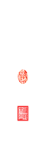






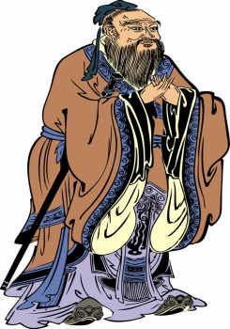
Meta-analysis of Genome-wide Association Provides New Insights into Tomato Flavor
Jiantao ZHAO
赵建涛
Mathilde CAUSSE
Christopher SAUVAGE

Slide 2

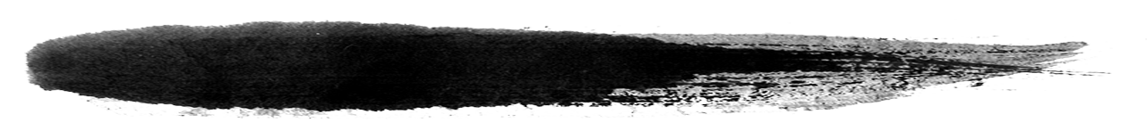
Context
1
Background
Materials
Methods
Challenges
Expectations
Results
2
3
4
5
6

Slide 3
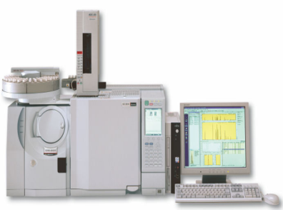
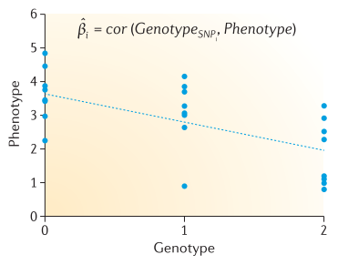
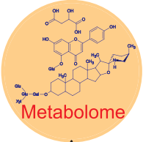
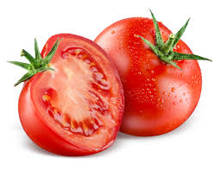
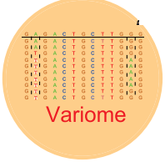
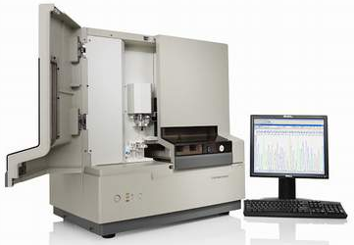
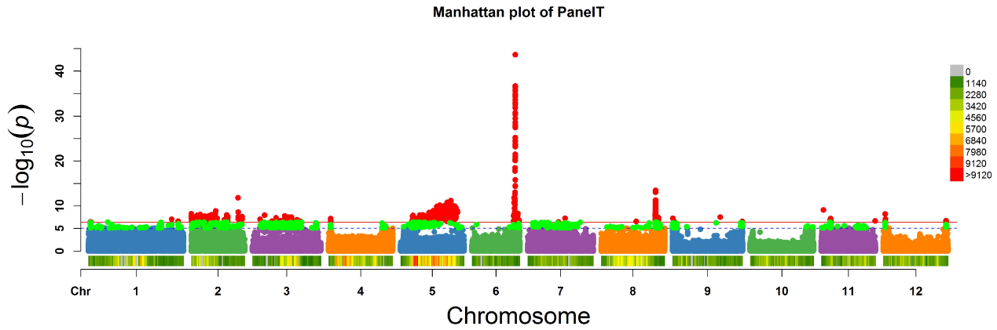
Background
Materials
Methods
Results
Challenges
Expectations
Genome-wide association study (GWAS)
What’s inside?
GWAS
How it works?
p=2*(1-pnorm(abs(β/se(β))))
Pasaniuc and Price 2017 Nat Rev Genet

Slide 4
Background
Materials
Methods
Results
Challenges
Expectations
Landmarks in tomato
1st Tomato genome
Wild Tomato genomes
SOLCAP
100 Tomato genomes
50 Tomato genomes +
CBSG
360 Tomato genomes
2012
2013
2014
2015
2016
2017
2018
Metabolites
Panel S
Flavor
Panel B
Flavor
Panel T
Nature 2012; Nat Genet 2014; Plant Physiol 2014;
Plant J 2014; New Phytol 2017; Science 2018; Cell 2018

Slide 5
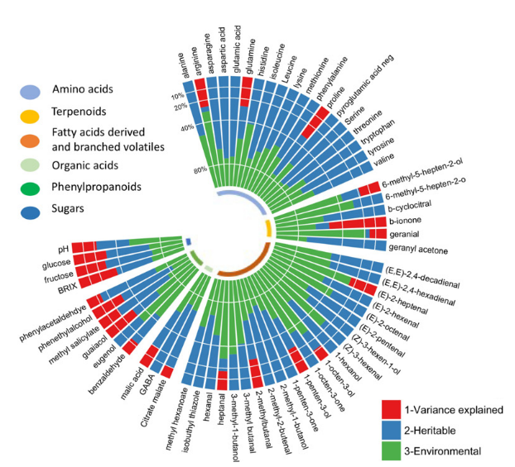
Background
Materials
Methods
Results
Challenges
Expectations
Missing heritability
Bauchet et al. 2017 New Phytologist

Slide 6
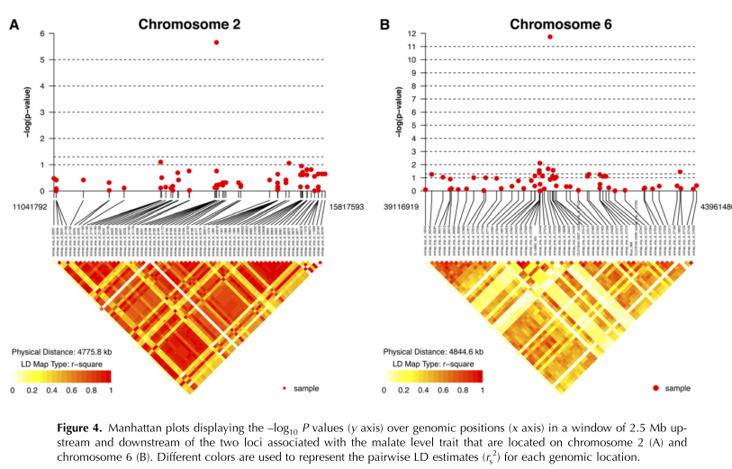
Background
Materials
Methods
Results
Challenges
Expectations
Linkage disequilibrium
: The non-random association of alleles of different linked polymorphisms in a population.
Minimum of SNP density
Candidate genes validation
Sauvage et al. 2014
Plant Physiology

Slide 7
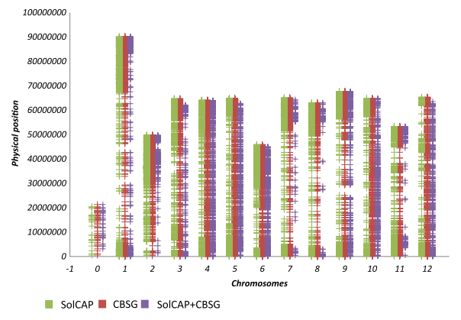
Background
Materials
Methods
Results
Challenges
Expectations
SNP arrays are limiting genome coverage
Sauvage et al. 2014 Plant Physiol;
Bauchet et al. 2017 New Phytol

Slide 8
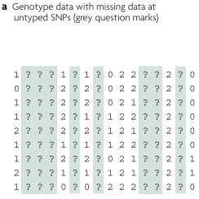
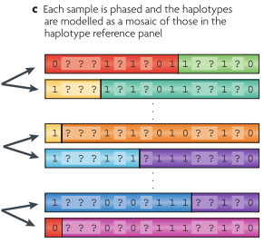
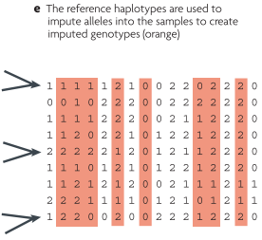
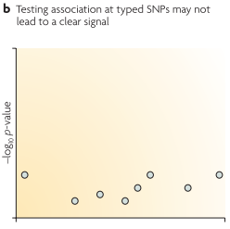
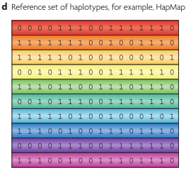
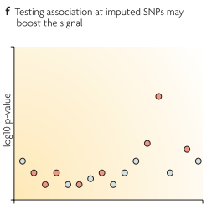
Background
Materials
Methods
Results
Challenges
Expectations
Imputation to overcome SNP density problem
Marchini and Howie, 2010 Nature Reviews Genetics

Slide 9
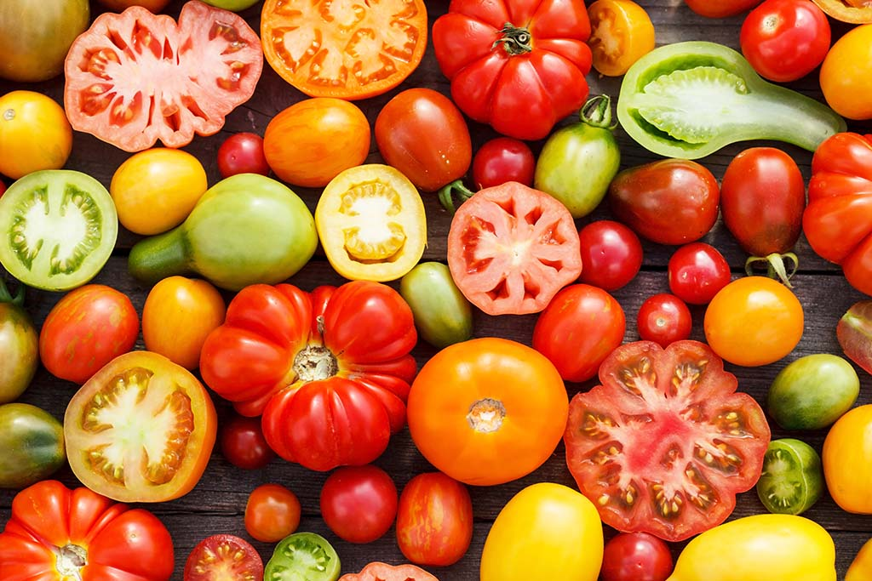
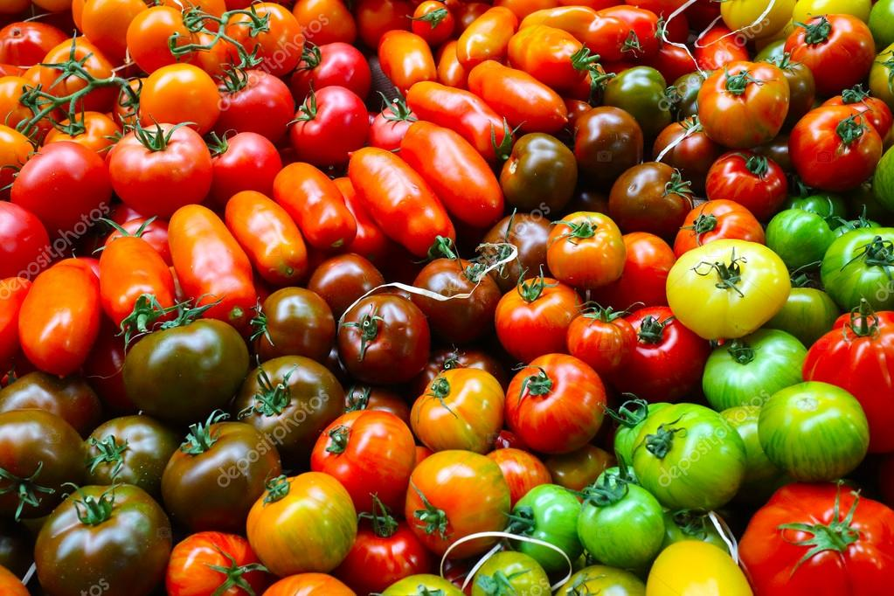
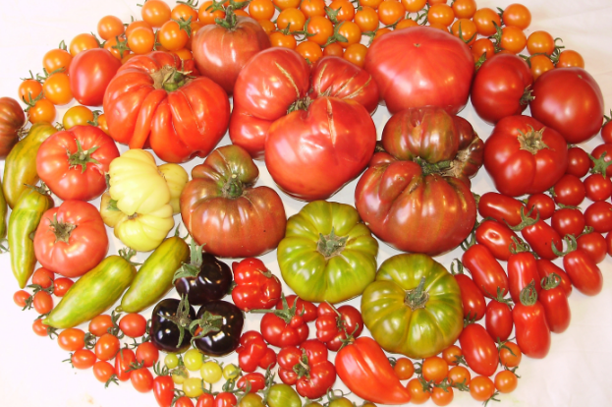
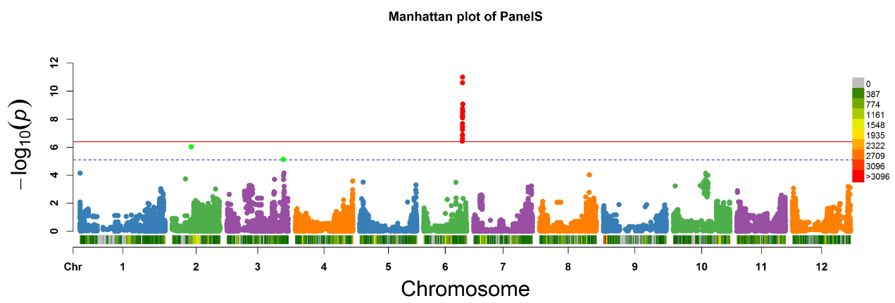
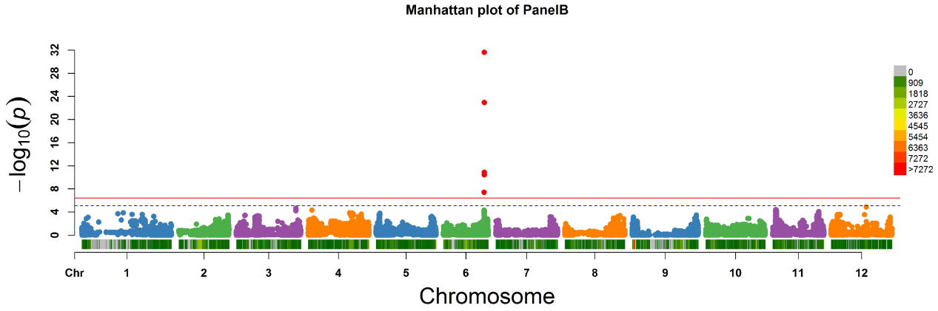
Background
Materials
Methods
Results
Challenges
Expectations
Heterogeneity across studies
Heterogeneity: The variation in the genetic effects observed among combined studies.
Example with malate content

Slide 10
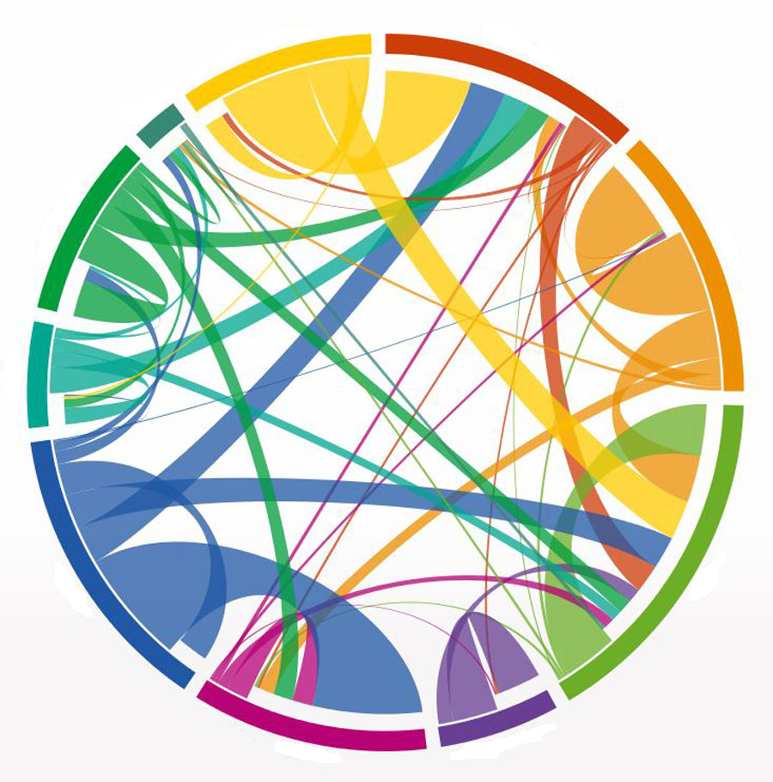
Background
Materials
Methods
Results
Challenges
Expectations
Genetic factors
Environments
Statistical factors
Factors leading to Heterogeneity
G X E interactions
LD
Measurements
Population structure
Imputation
Genotyping

Slide 11

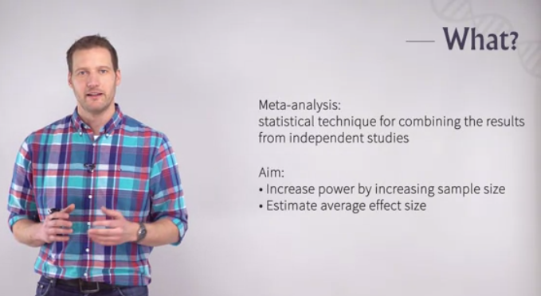
Background
Materials
Methods
Results
Challenges
Expectations
Meta-analysis
Meta-analysis
What?

Slide 12
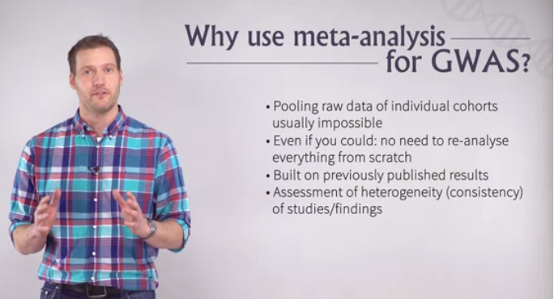
Background
Materials
Methods
Results
Challenges
Expectations
Meta-analysis
Zeggini and Ioannidis 2009 Nat Genet; Evagelou and Ioannidis 2013 Nat Genet Rev; Sud et al. 2017 Nat Rev Cancer; Wijmenga et al. 2018 Nat Genet

Slide 13

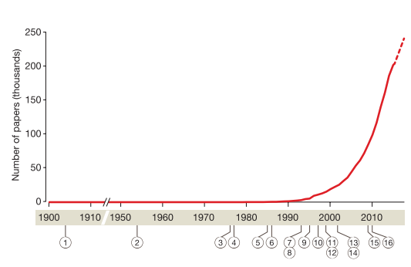
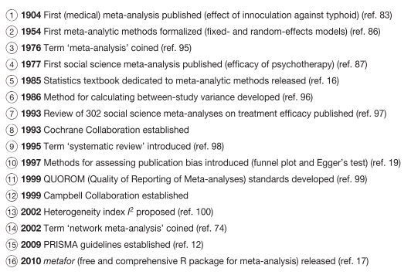
Background
Materials
Methods
Results
Challenges
Expectations
Landmarks
Gurevitch et al. 2018 Nature

Slide 14
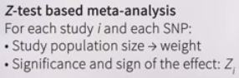

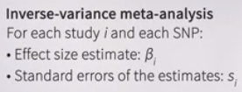
Background
Materials
Methods
Results
Challenges
Expectations
Models
--- for meta-analysis
Z-test
Fixed-effect model
Inverse-variance
No Geno & Pheno !!!
Meta-analysis
Random-effect model
Han Eskin
=> However we need to estimate beta values and standard errors from GWAS.

Slide 15
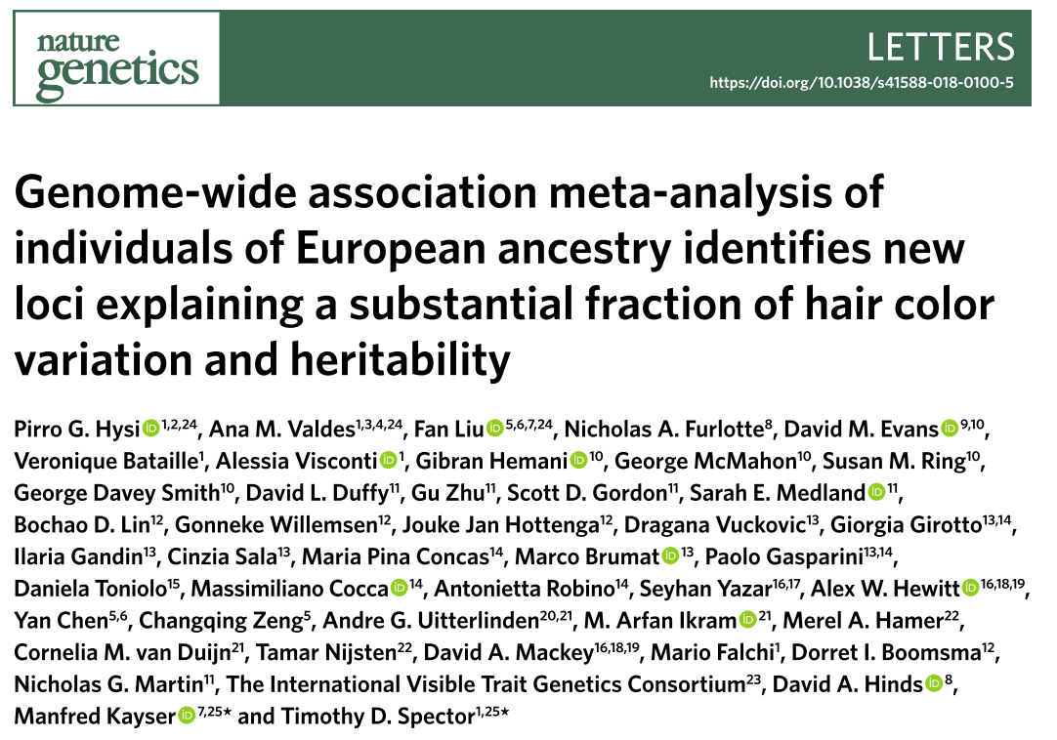
Background
Materials
Methods
Results
Challenges
Expectations
Example in human
GWAS

Slide 16
Background
Materials
Methods
Results
Challenges
Expectations
Promises from Meta-analyses
Increase statistical power
Reduce false-negative associations
Increased precision of estimated variance
Account for missing heritability
Facilitate detection of rare variants
Zeggini and Ioannidis 2009 Nat Genet; Evagelou and Ioannidis 2013 Nat Genet Rev; Sud et al. 2017 Nat Rev Cancer; Wijmenga et al. 2018 Nat Genet

Slide 17
Background
Materials
Methods
Results
Challenges
Expectations
Main questions
What can we gain from genotype imputation in tomato?
Will imputation-driven GWASs have a better performance?
What is the benefit of conducting a meta-analysis of GWASs in tomato?

Slide 18
Background
Materials
Methods
Results
Challenges
Expectations
Table 1. Summaries of different GWAS panels used in this study
GWAS panel | Sauvage et al., 2014 | Bauchet et al., 2017 | Tieman et al., 2017
Panel code | S | B | T
Population size | 163 | 300 | 402
Phenotype replications | 2007 and 2008 | 2011 and 2012 | Florida and Israel
Genotype method | SOLCAP arrays | SOLCAP and CBSG arrays | Whole-genome sequencing
Genotyped SNPs | 5,995 | 9,013 | 2,014,488
MAF | 0.037 <MAF<0.45 | MAF>0.01 | MAF>0.05
Population structure | K=2 | K=6 | K=5
GWAS model | MLMM | MLMM | EMMAX
Sugars and acids | Citrate | Citrate | Citrate
 | Fructose | Fructose | Fructose
 | Malate | Malate | Malate
Amino acids | Asparagine | Asparagine
 | Aspartate | Aspartic acid
 | GABA | GABA
 | Glutamine | Glutamine
 | … | …
Volatiles |  | (E)-2-heptenal | (E)-2-heptenal
 |  | (E)-2-hexenal | (E)-2-hexenal
 |  | (Z)-3-hexen-1-ol | (Z)-3-hexen-1-ol
 |  | (Z)-3-hexenal | (Z)-3-hexenal
 |  | … | …

Slide 19
Background
Materials
Methods
Results
Challenges
Expectations
Global strategy
Genotype
Phenotype
Geno S
Geno B
Geno T
Pheno T
Pheno B
Pheno S
Sugars and organic acids
Sugars and organic acids
Sugars and organic acids
Genotype imputation
Volatiles
Volatiles
NA
Quality control
NA
Amino acids
Amino acids
Geno S’
Geno B’
Geno T’
GWAS S
GWAS T
GWAS B
Meta-analysis
Search for Candidate gene
(LD heuristic approach)

Slide 20
Background
Materials
Methods
Results
Challenges
Expectations
Reference
Imputed
Genotyped
After final quality control (Q>0.6), the number of SNPs increased from 5984 to 209,152 (35.55-folds) for panel S.

Slide 21
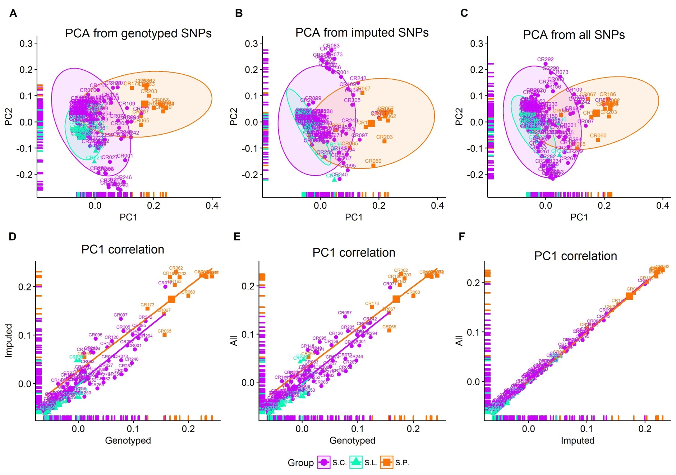
Background
Materials
Methods
Results
Challenges
Expectations
Principal component analysis
Figure S5. Principal component analysis (PCA) comparison before and after genotype imputation for panel S. (A) PCA of genotyped SNPs. (B) PCA of imputed SNPs (r² ≤ 0.2). (C) PCA of all SNPs (r² ≤ 0.2). (D) Correlation between genotyped and imputed SNPs (E) Correlation between genotyped and all SNPs (F) Correlation between imputed and all SNPs.

Slide 22
Background
Materials
Methods
Results
Challenges
Expectations
Meta-analysis summary
Meta-analysis model:
Fixed-effect model & Random-effect model
A total of 788 tomato accessions and 2,316,117 SNPs from three GWAS panels were used for the final meta-analysis for 25 flavor-related traits.
Meta-analysis identified a total of 218 significant loci associated with sugars (fructose and glucose), organic acids (malate and citrate), amino acids and flavor-related volatiles, 140 of which are novel.

Slide 23
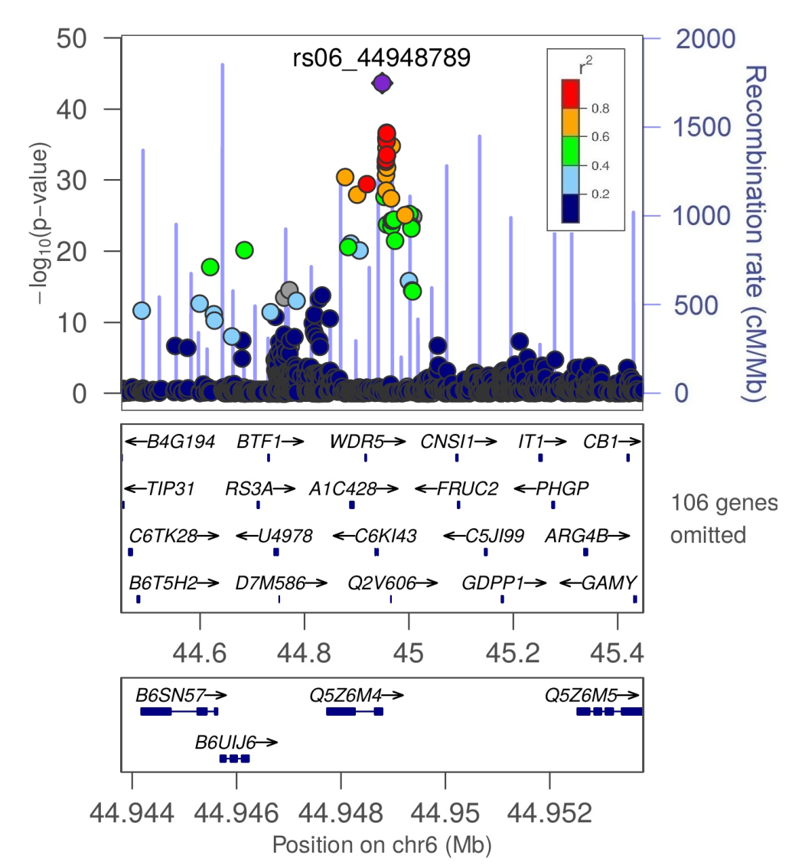
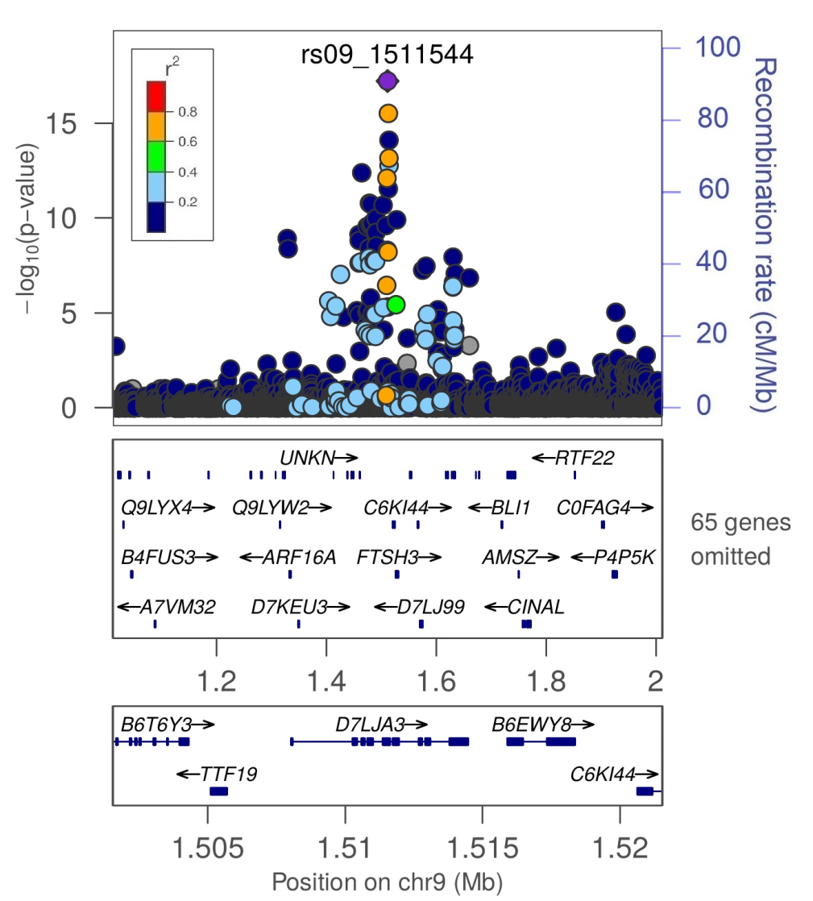
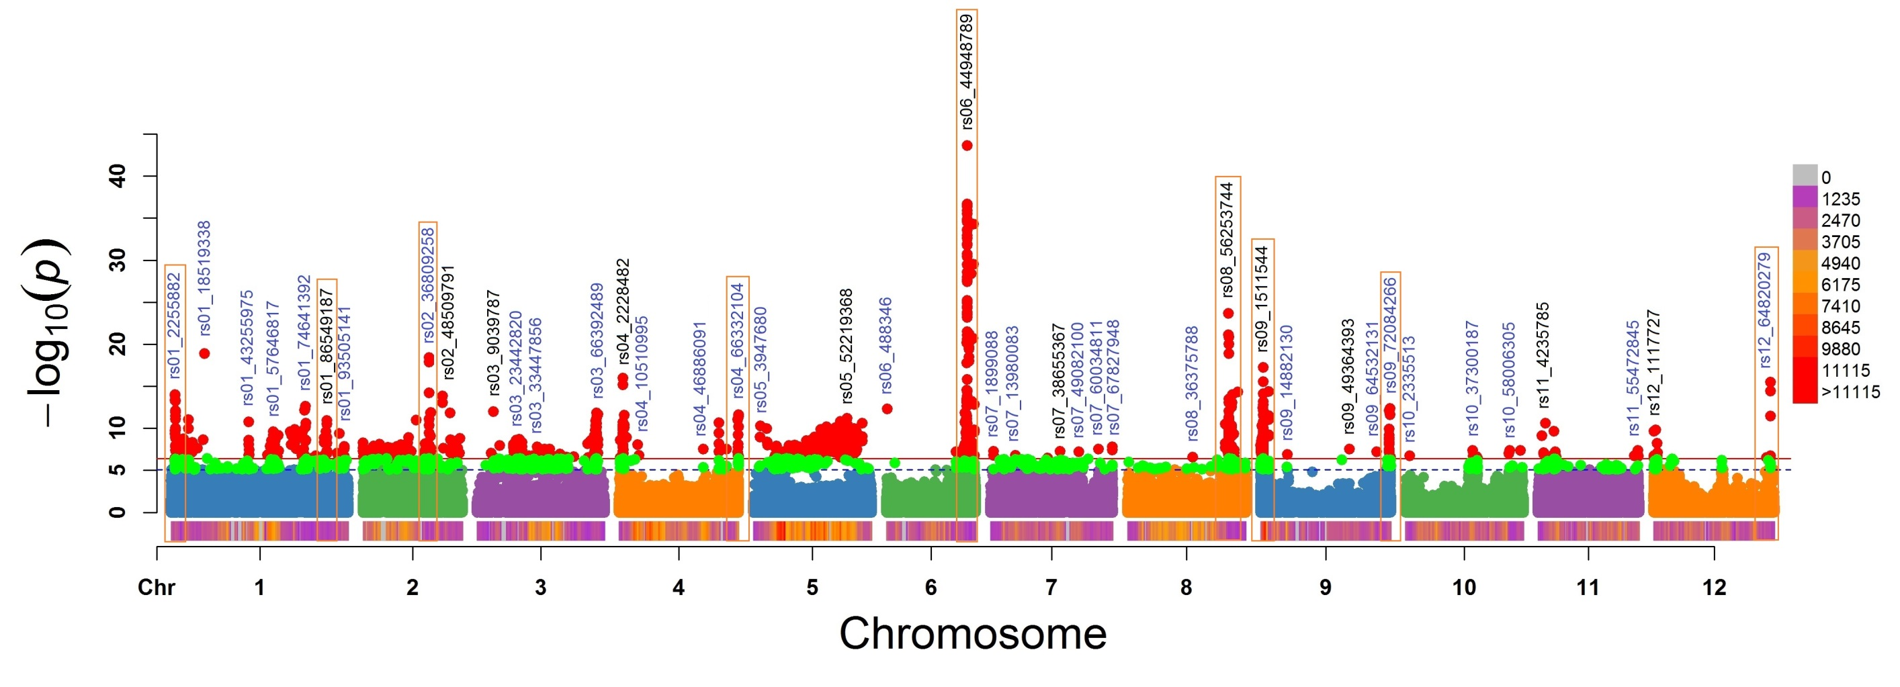
Background
Materials
Methods
Results
Challenges
Expectations
Malate content
Al-activated malate transporter 9
Glycosyltransferase

Slide 24

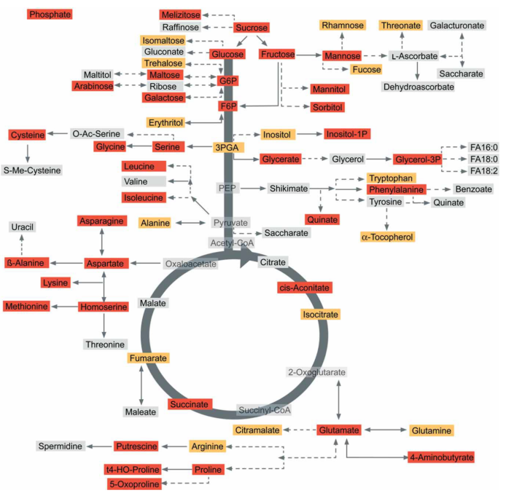
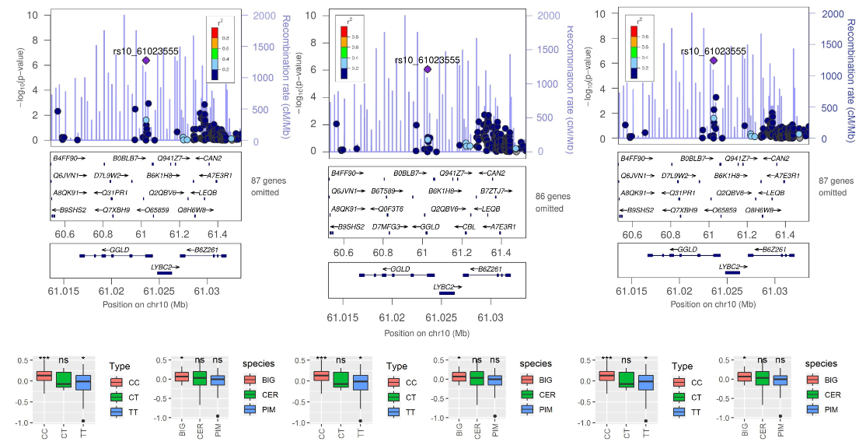
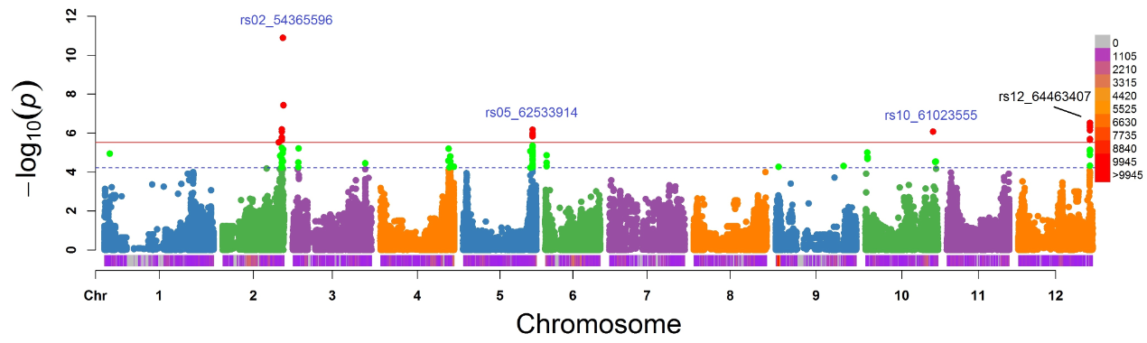
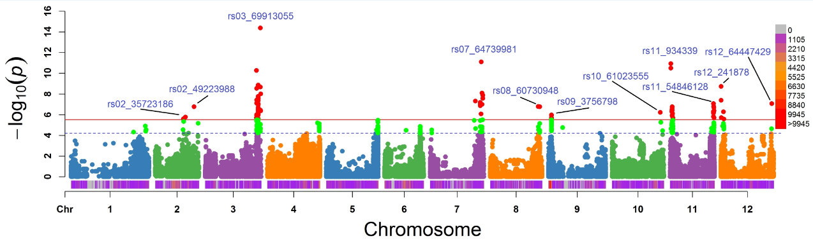
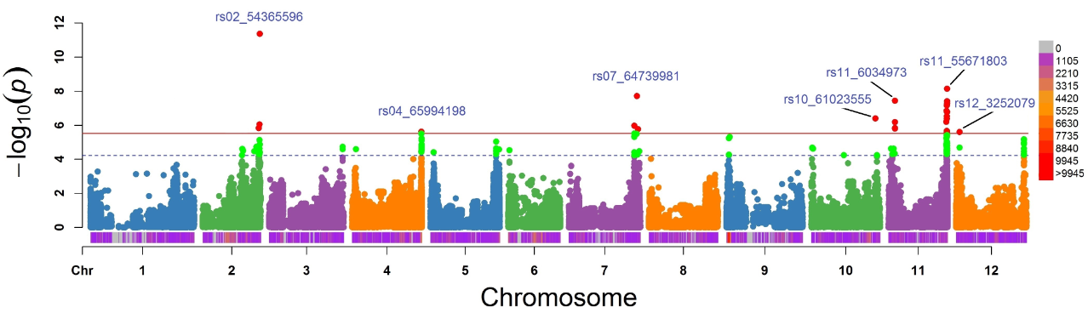
Background
Materials
Methods
Results
Challenges
Expectations
Polygenetic effects
Asparagine
galactono-1,4-lactone dehydrogenase
Serine
Threonine

Slide 25
Background
Materials
Methods
Results
Challenges
Expectations
Answers!!!
YES!!!
Imputation works and can greatly increase the density of SNPs in high quality!
YES!
Imputation-driven GWASs do have a better performance, but limited!
YES!
Meta-analysis of GWASs can greatly promote our the identification of novel candidate genes

Slide 26
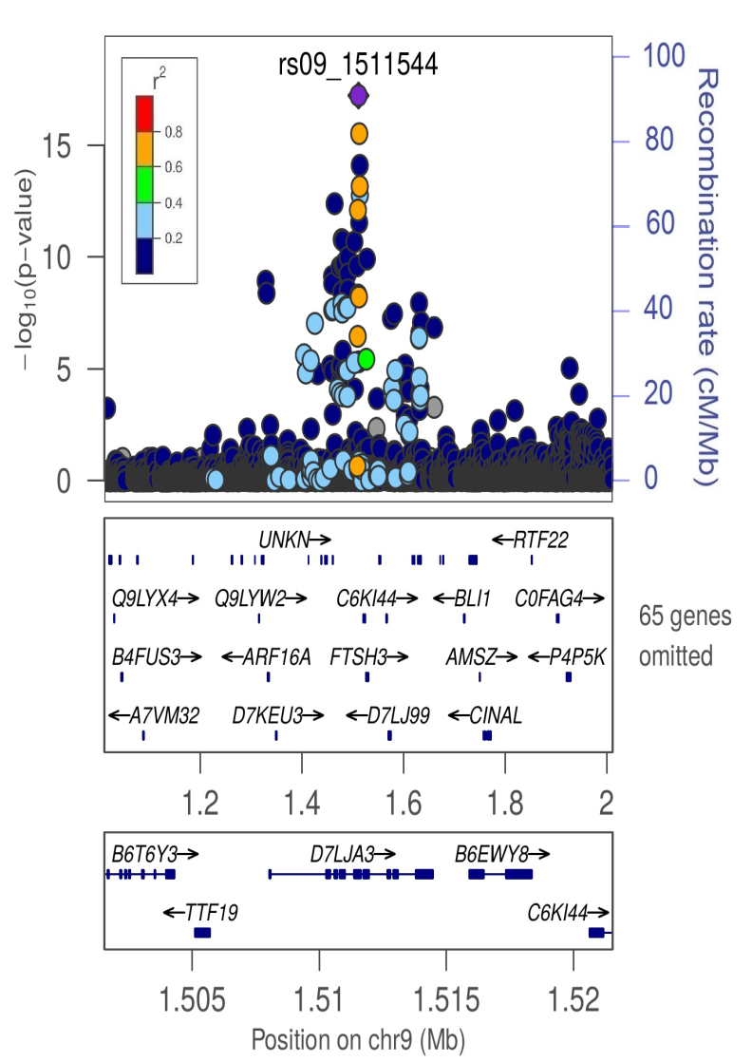
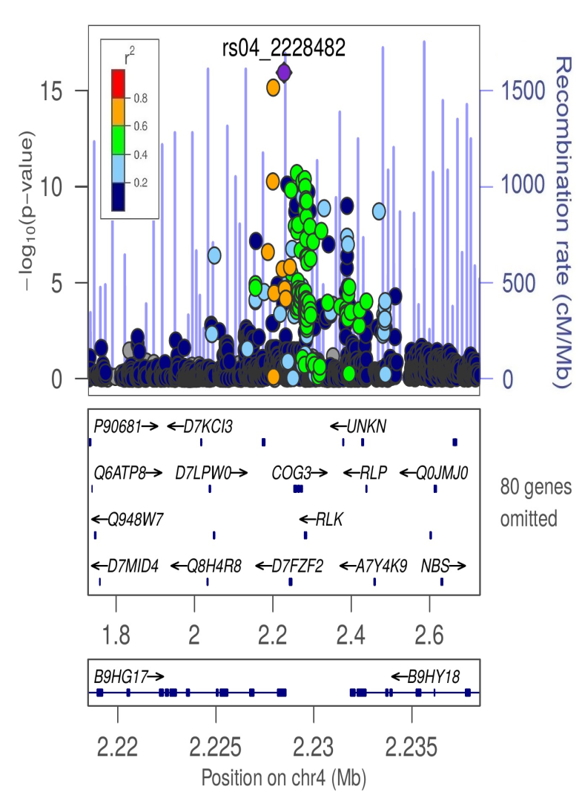
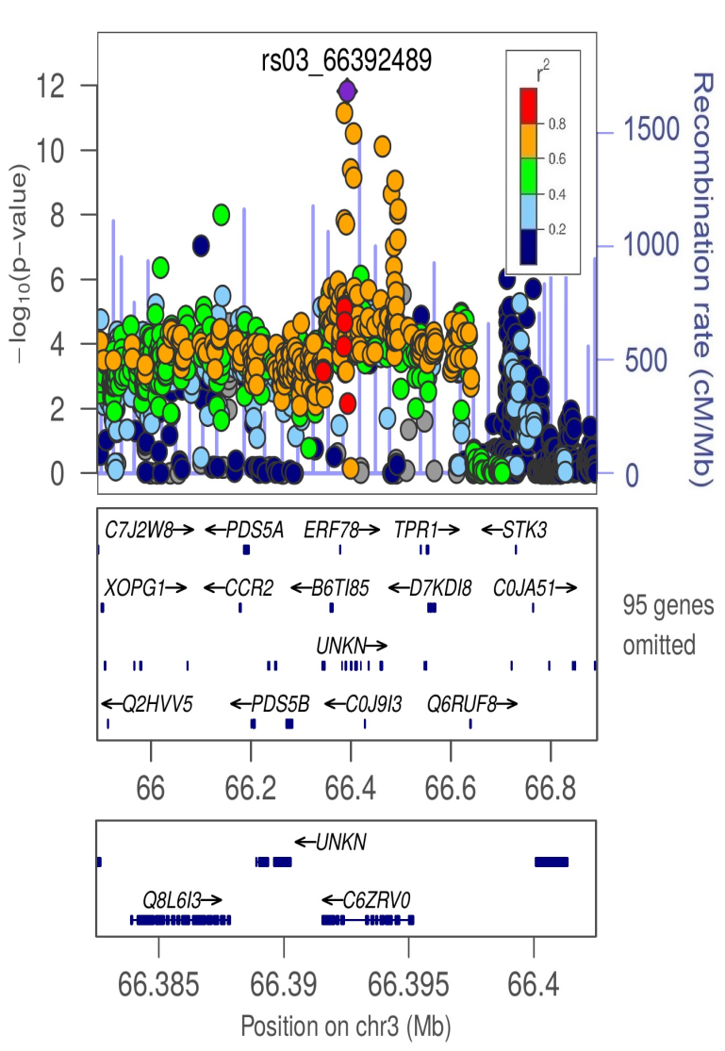
Background
Materials
Methods
Results
Challenges
Expectations
Strong LD!!!

Slide 27
Background
Materials
Methods
Results
Challenges
Expectations
GWAS will still be powerful and popular.
Meta-analysis of GWAS will witness increasing attention and will be the next new era.
Integrating obtained knowledge into genomic selection will be more promising in the real tomato breeding practices.
This will be the next story!

Slide 28

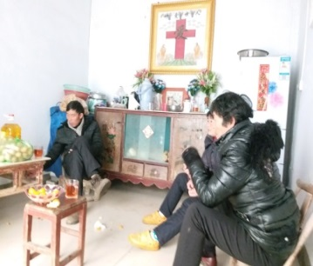

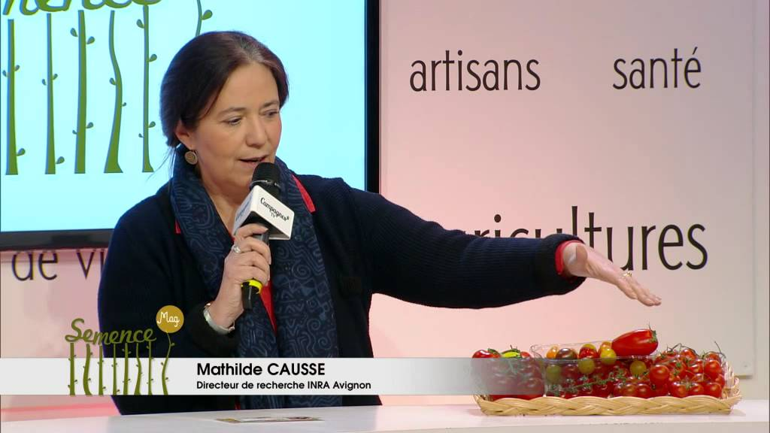
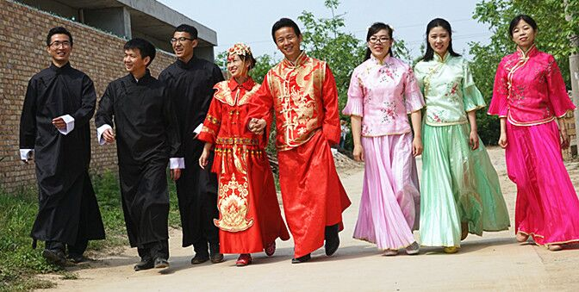


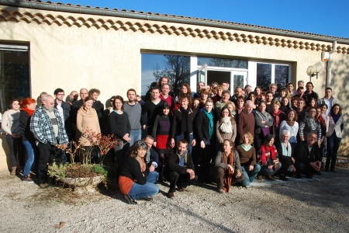
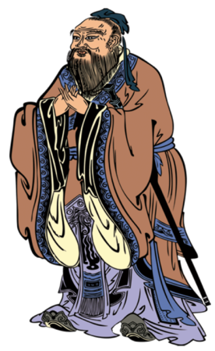



Acknowledgements

Slide 29

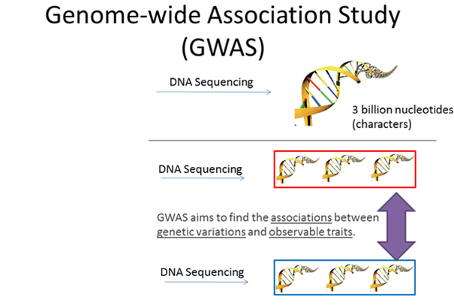


Background
Materials
Methods
Results
Challenges
Expectations
What’s and Why GWAS?
Haines et al. 2005 Science – First GWAS;
92% of the human genome has been completed.

Slide 30




Background
Materials
Methods
Results
Challenges
Expectations
Limitations
高胆固醇血症/Hypercholesterolemia/Hypercholestérolémie/Apoa2

Slide 31

Background
Materials
Methods
Results
Challenges
Expectations
Recombination map
EXPIM 2012
Inferred
Figure 1 Relationship between genetic (cM) and physical positions (Mbp) within each chromosome. Genetic positions of SNPs of the EXPIM 2012 population were indicated in orange and the inferred genetic positions for SNPs in the reference panel were indicated in green.

Slide 32


Background
Materials
Methods
Results
Challenges
Expectations
How to be a billionaire?!!!
Germination rate
Total seeds = (16,000,000 × 4,000)/95%
= 68,000,000,000 (plants)
Total profits = 68,000,000,000 × 500/1000
= 34,000,000,000 ¥
= 4,500,000,000 € !!!
Sell 20% of the total seeds!!!
Total fruits = 42,000,000,000 kg × 3 ¥/kg
= 1,260,000,000,000 ¥
=170,000,000,000 €
Sell 1.7% of the total tomato!!!

Slide 33





Background
Materials
Methods
Results
Challenges
Expectations
Which tomato???

Slide 34

Background
Materials
Methods
Results
Challenges
Expectations
Pathway!!!
Klee and Tieman 2018 Nature Reviews Genetics

Slide 35





Background
Materials
Methods
Results
Challenges
Expectations

Slide 36


Background
Materials
Methods
Results
Challenges
Expectations
Reference
360 tomato accessions
221 tomato accessions
Lin et al. 2014 Nat Genet

Slide 37

Background
Materials
Methods
Results
Challenges
Expectations
Complexity
Schauer et al. 2006 Nature Biotechnology

Slide 38

Background
Materials
Methods
Results
Challenges
Expectations
Imputation quality threshold
Before imputation quality (Info) filtering
After imputation quality (Info) filtering

Slide 39

Background
Materials
Methods
Results
Challenges
Expectations
Imputation
Howie et al.
2009 PLoS Genet;
2012 Nat Genet

